Slide 1
Helpline Programming
FSS X 2024
Presented by: Pam S. – Florida Region IT Resource Coordinator

Slide 2
Did you know…
Yap and BMLT share the same username and password, if you change the password it changes for both systems
You have the ability to text a hotline with a specific zip code and get meetings in that area.
Yap allows you to customize your area’s helpline:
You can select multiple languages
You can personalize your greeting and voicemail recordings
You can add the Just for Today Daily Meditation daily reading AND SPAD Readings as an option for callers

Slide 3
Website: Bmlt.sezf.org/zonal-yap/admin

Slide 4
Home Screen
Here you can navigate to the different tabs to set up your area’s Call Handling, Volunteers and Schedule

Slide 6
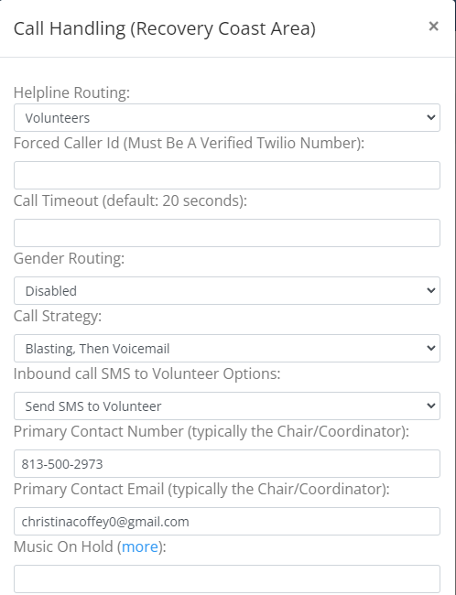
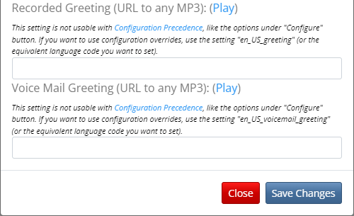

Slide 8
Configure

Slide 9
Configure

Slide 10
Configure

Slide 11
Configure

Slide 13
Voicemail

Slide 14
Volunteer

Slide 15
Volunteer

Slide 16
Volunteer

Slide 17
Volunteer

Slide 18
Volunteer

Slide 19
Volunteer

Slide 20
Volunteer

Slide 21
Volunteer

Slide 22
Volunteer

Slide 23
Volunteer

Slide 24
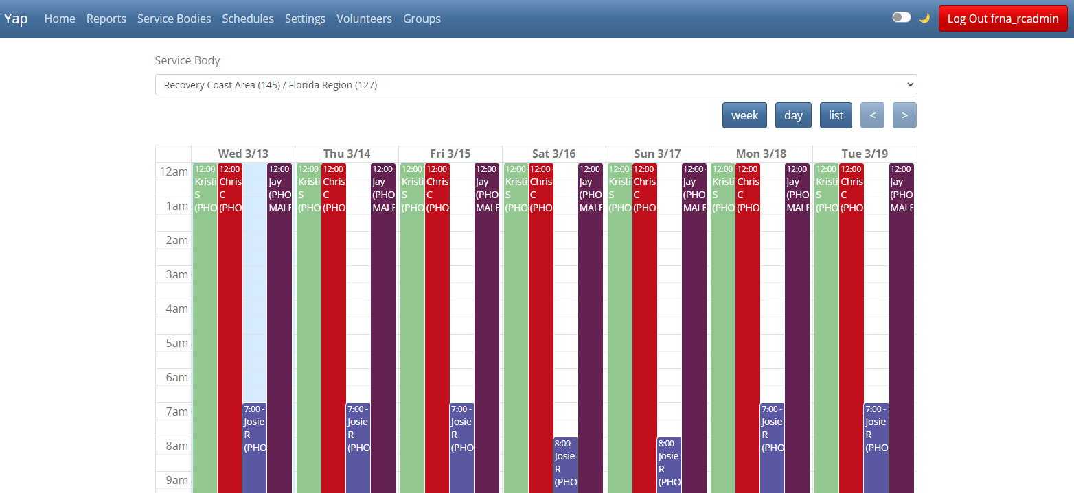
Schedule

Slide 25
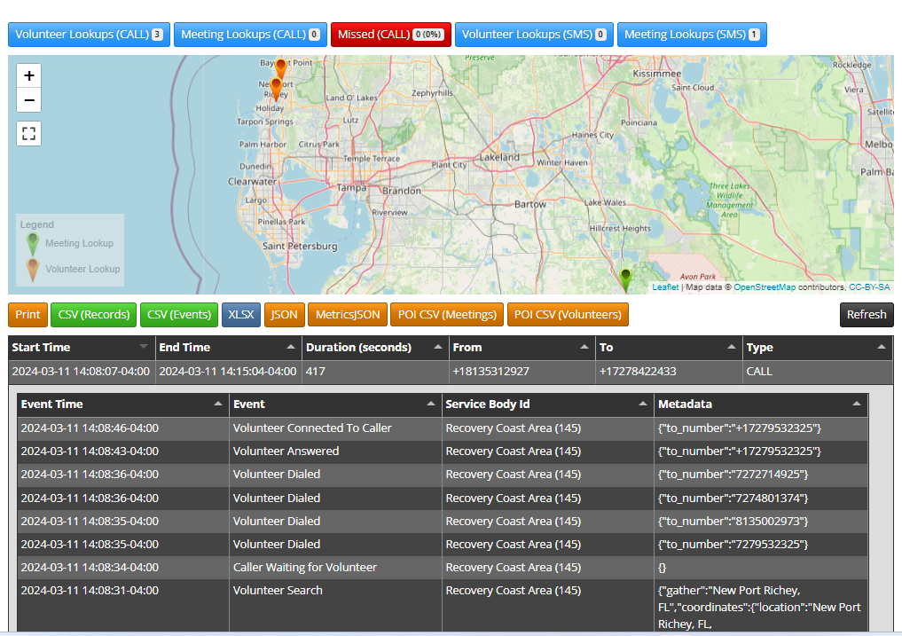
Reports

Slide 26
What does your Area get from Yap?
Free to Areas to use
Really cool features to customize your Area’s call handling
Has options to speak to a volunteer, look up a meeting, or if you want read the JFT to the caller

