Slide 1
Hospital & Institutions Orientation
Rev 2.0
Jan 2024

Slide 2
H&I History
When was the first Narcotics Anonymous H&I subcommittee meeting?
The first NA H&I subcommittee meeting was in 1963 in southern California

Slide 3
H&I guidelines/handbook history
Prior to 1984, H&I used a version of guidelines created by the World Literature Committee. The WSC H&I Committee in 1984 held workshops to rewrite those original H&I guidelines.
At the World Service Conference (WSC) in 1985, the conference approved the “navy blue version” of the H&I guidelines.
The name was changed from “Guidelines” to “Handbook” in 1986
WSC’89: the conference approved the Hospitals and Institutions Handbook unanimously.
WSC’96: the conference approved minor changes to some existing chapters, the new chapter “Forensic and Psychiatric Units,” and revisions to the “Learning Days” and “Preparation for Learning Days” chapters.
WSC’97: the conference approved changes to the “Do’s and Don’ts” in the Hospitals and Institutions Handbook.

Slide 4
H&I vs. regular NA meetings
Are H&I meetings the same as regular meetings?
Not self supporting, uses Area funds – no 7th tradition
Anonymity not protected
Inmates/clients cannot get out to regular meetings
May be under surveillance
H&I must follow the rules of the facility such as restricted access, no cell phones, or dress codes
Not Autonomous – Panels must follow Area guidelines and take direction from the NNMA H&I

Slide 5
What does Hospitals & Institutions do?
Carrying the message of recovery to those who cannot attend meetings in the community
Panel meetings to treatment centers and institutions
Provide meeting guides for when they get out
Sending books & literature to institutions
Writing letters – Steps Behind the Walls

Slide 6
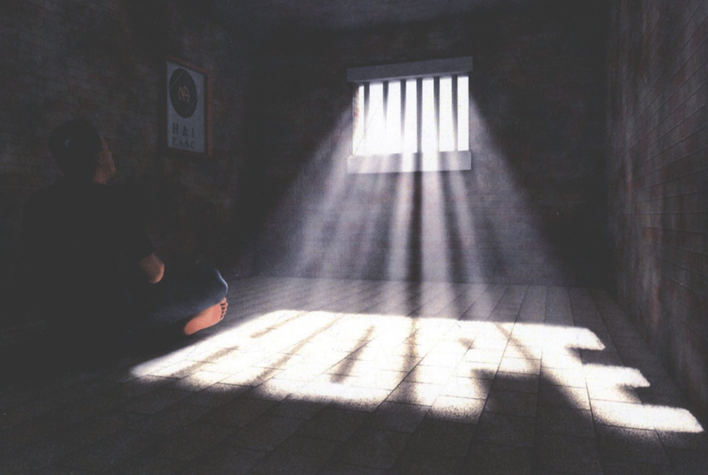
Role Play
Notes:
Run slide show to see full slide.

Slide 7
Types of Treatment Facilities:
SHORT TERM
Detox Centers – 3-6 days
28 Day Facilities
Outpatient Facilities – Not eligible for H&I
LONG TERM
Recovery Houses– May or may not eligible for H&I
Halfway Houses – Not eligible for H&I
Psychiatric Hospitals

Slide 8
Types of Institutional Facilities:
Correctional Facilities
Long Term - prisons
Short Term - jails
Adolescent

Slide 9
H&I and PR
What are the connections between H&I and PR?
PR connection - building and maintaining relationships with facilities particularly when starting
H&I and PR cooperation – joint presentations
Working with PR committees when presenting information about NA to those outside the fellowship such as jails.
If there is no PI/PR resource person available, use PR guidelines and PR material
Correctional facilities – See Chap 6 PR handbook
Treatment Facilities – See Chap 7 PR handbook

Slide 10
H&I Functions at Multiple Levels
Area Service Committee
Provides literature and funding for the H&I sub-committee
H&I sub-committee
H&I sub-committees are directly responsible to the Area members, the Area Service Committee, and their guidelines
H&I Panel members
Members are directly responsible to the sub-committee, run panel meetings, maintain relationships with facilities, and provide written correspondence
Panel Leaders may set meeting format
Members are qualified by the subcommittee
Speakers by the Panel Leader

Slide 11
Sexual Harassment
Zero tolerance!
Don’t say anything about their body
No relationships – not even consensual ones
If you have a current relationship with a client or inmate you need to leave.
Harassment is in the eyes of the victim
A person may share about being raped or abused. Asking them “what is your part?” is harassment.
The prisons, most jails, and some treatment centers require you to attend sexual harassment training

Slide 12
PREA
Prison Rape Elimination Act
Federal law – All prisons and Jails to comply
All people entering a facility including volunteers are mandatory reporters
If you are handed a note, you MUST take it and read it
If it says the inmate is being abused, report it
Individual facilities will provide reporting procedures
Anything else, hand it back
No consensual sex
Clients and especially inmates may not give consent. Illegal with inmates. You may be charged with a crime.

Slide 13
Steps Behind the Walls
This is a new program in Rio Grande Region that writes letters to inmates to work steps.
It’s not actually sponsorship but more guiding an inmate through the steps without sharing personally identifiable information.
Confidentiality is required to protect NA and the NA members.

Slide 14
Program Flow
H&I Panel
Flyer
With PO Box
Inmate
Steps Behind the Walls
1. Inmate Request
Coordinator
PO Box
2. Agreement
Inmate
3. Signed Agreement
Step
Guide
4. Step Working Guide
Inmate
5. Written Step Work
Coordinator
PO Box
Step
Guide
6. Response to Step Work / Next Step
Inmate

Slide 16
Panel Leader Do’s
Screen all speakers, and chairpersons and clarify the rules with whomever you bring into the facility. Especially the sexual harassment policy. Panel members are screened by the subcommittee.
Start and end on time!
Adhere to clean time requirements of the treatment facility and the H&I sub-committee guidelines
Ensure that a clear NA message of recovery is carried by all panel members
Have meeting guides and literature available. Put in orders on time.
Attempt to get all agreements in writing. If it is special, be sure to get it in writing and bring it to the H&I sub-committee for review
Explain briefly, during the meeting, what H&I is.
Clearly state that N.A. is separate from the treatment facility and from other fellowship
Emphasize that NA recovery is available to all addicts, regardless of drug(s) used
Explain the language that we use (addict, clean, recovery, clean time) and why we use it (the First Step of NA and Sixth Tradition of NA)

Slide 17
Panel Leader Don'ts
Don’t bring any contraband items or weapons into the treatment facility or institution.
Don’t do anything that may be considered sexual harassment! No sexual jokes.
Don’t take messages or carry letters in or out of the facility
Don’t show favoritism to any resident(s)
Don’t bring an NA member who has friends and/or family in the treatment facility or institution
Don’t attend H&I facilities alone if possible
Don’t make an H&I presentation to a facility by yourself

Slide 18
Panel member Do’s
Involve residents with the meeting, especially those in prison or long-term treatment facilities (readings, etc.)
Emphasize the importance of getting to an N.A. meeting the first day out
Emphasize the importance of a sponsor, regular N.A. meeting attendance, and group commitments after release
Explain the language that we use (addict, clean, recovery, clean time) and why we use it (the First Step of NA and Sixth Tradition of NA)
Obey the dress code, especially in institutions and exercise common sense.
Adhere to the security regulations at all times.

Slide 19
Panel leaders getting speakers
A Panel leader getting speakers for a treatment center may wish to use the speaker list provided by the Area H&I subcommittee. These speakers are known to carry a good message.
Panel leaders in a jail or prison must get speakers that are cleared and approved by the facility.

Slide 20
Panel Member Don'ts I
Don’t debate any issue involving the treatment facility’s rules, regulations, programs, or other fellowships with residents and staff
Don’t do anything that may be considered sexual harassment! Not even jokes.
Don’t discuss conditions within the treatment facility
Don’t discuss treatment staff members with resident(s)
Don’t discuss resident(s) with the treatment facility staff
Don’t sponsor resident(s) of the treatment facility that you are attending as an H&I member until they are released
Don’t accept money or gifts from, or give money or gifts to, any resident

Slide 21
Panel Member Don'ts II
Don’t give anyone within the facility your address or telephone number or info from another NA member
“I am here for you, this is not about me.”
Don't break another person's anonymity.
Don’t emphasize ‘war stories’ while sharing an NA message of recovery
Don’t wear flashy jewelry and don’t carry excessive cash
Don’t use excessive profanity
Don't show favoritism to any resident(s).
Don't take messages or carry letters in or out of the facility.
Don't ask what type of crime an inmate has been convicted of, or discuss guilt or innocence.

Slide 22
Working with others:
One simple guideline in facilities that separate men from women or that are unisex:
Men work with men
Women work with women

Slide 23
Literature Do’s
Make N.A. meeting schedules available to the residents with the regional and local helpline phone number and ask them to call it when getting out
Use the literature recommended for H&I work as provided by the H&I subcommittee
Provide facilities with literature order forms and encourage the facility to supply its own NA literature

Slide 24
Questions and Answers
Encourage questions concerning what was presented at the meeting or about N.A. but here are a few things to keep in mind:
Don’t let one person dominate, get questions from as many different people as possible.
Minimize cross-talk

Slide 25
Questions and Answers
Remember that N.A. has no opinion on outside issues.
Occasionally you may be asked about:
Other programs or fellowships
Religion, politics, or sports
The facility rules and regulations
Many other issues that do not pertain to recovery from addiction in the N.A. fellowship
It is very important that we are not drawn into these types of discussions! Always remember to share about your experience, strength, and hope about YOUR recovery in N.A. What N.A. has done for you!

Slide 26
H & I Guidelines for Panel Members:
H&I requirements are set by each Area not the Region. Here are some suggested guidelines
You must have at least 6 months abstinence from all drugs and be working a program with a sponsor
You have a strong N.A. message of recovery from addiction
You are willing to comply with ALL of the H&I subcommittee and facility requirements.
You are able to carry the message in a responsible way (refer to Do’s and Don'ts)

Slide 27
H&I Suggested Clean Time Guidelines
Any N.A. member may attend H&I sub-committee meetings to learn regardless of clean time
4-6 months-Observation only to attend a treatment center H&I panel. Please don’t speak unless permitted by Panel Leader
6 months- Panel Member
1 Year- Panel Leader/Coordinator
1 year plus clearance for Jail or Prison

Slide 28
H&I Requirements for jail/prison
Varies with the facility
Prison in New Mexico requires 3 years off parole/probation
Completion of the facility training and clearance
You do NOT need to have ever been in jail or prison to carry the message

Slide 29
How to pick an H&I meeting for you
You may want to consider attending a treatment center meeting as your first H&I commitment since those meeting do not require a clearance.
You must have clearance to do an institution meeting. Just because you meet the criteria for clearance, does not mean your clearance will be approved. Please see the local Area H&I chairperson for clearance criteria as they vary.
Consider if you have a conflict of interest at the facility or with people in the facility, if you do it may be prudent to target a meeting where you do not have a conflict.
Usually you must go to the Area H&I subcommittee meeting to be considered for an H&I panel member

Slide 30
Orientation
H& I Orientation is a period that allows N.A. members to become familiar with H&I work so they are not rushed into it without any preparation for this service.
As a part of orientation, experienced panel members may bring those who are new to H&I (with less than 6 months clean time) to an H&I meeting or presentation as an observer.
This allows them to listen and see how the meetings or presentations really work.
Also, this helps many feel more comfortable to try before commitment.

Slide 31
Personal Commitments Check
Do you have the time?
Have you talked to your sponsor and your family about making this commitment?
Please DO NOT volunteer for an H&I meeting/ presentation if you are not sure you can fulfill your commitment.
(If you are a speaker and you cannot make it, give the coordinator at least 48 hours notice to fill your position.)

Slide 32
Reaching Out
This is an H&I newsletter
Written by and for addicts in institutions
http://www.na.org/?ID=reaching-out-index

Slide 33
Small Group Discussion

Slide 34
H&I Discussion Topics
Treatment Center
What do you do if you are a panel leader and see a panel member asking inappropriate questions such as “come over to my place after you get out?”
What do you do if you are a panel leader and a treatment center wants to bar specific individuals on your panel from entering the facility for an H&I panel meeting?
Can a person hold a position on staff at a treatment center and be on an H&I panel in the same treatment center? Explain why or why not. Prison
What do you do if an inmate hands you a note that reads: “Tell my mom I am OK”?
What do you do if an inmate hands you a note that reads: “I am being raped in my cell and I don’t know what to do”?

Slide 35
Questions?
Fermin G. (505) 974-3451, fermingjr@earthlink.net
George L. (505) 231-4677, georgelamonda01@gmail.com
Tom K. (408) 857-3438, tom@tomkondo.com

