Slide 1
Service Etiquette

Slide 2
Service Etiquette
The definition of service according to the Oxford Dictionary is, “The action of helping or doing work for someone.”
The definition of etiquette according to the Oxford Dictionary is, “The customary code of polite behavior in society or among members of a particular profession or group”.

Slide 3
Service in Narcotics Anonymous
Service in Narcotics Anonymous is a means by which we “give back” to the fellowship and program. There are many ways to honor the fellowship by doing service. There are service positions that have titles and clean time requirements and others that don’t have titles but are as important if not more important than most. Many members of the fellowship do service at many levels of the service structure. Some say that service is the price we pay for the life we get to live.

Slide 4
What are some of the reasons you do service?

Slide 5
The horror stories!
Hopefully, those blatant acts of disrespect are occurring on fewer occasions.
As we grow as individuals and as a fellowship we are maturing and hopefully behaving more respectfully toward one another.

Slide 6
How can we keep longtime members in service or how can we make service more attractive to all?
One of the issues that may cause individuals to avoid doing service could be a lack of service etiquette or mutual respect.

Slide 7
How the lack of Service Etiquette can adversely affect others
Many of us are passionate about our fellowship but oftentimes passion can look like anger.
Some of our members came from abusive or trauma laden lives and can be very uncomfortable with what they perceive as anger, causing people to walk away from service opportunities
Some of us have not yet begun the process of healing and the anger or contentiousness could cause further damage.
We have seen members use their anger to control the atmosphere in a room and we have seen members bully others with their language and actions.
This behavior can be off putting for others and may make some question the want or desire to serve.

Slide 8
How can we make service attractive, welcoming, and safe for everyone?
It is the facilitator’s responsibility to quell any sort of distracting or disruptive behavior.
Without a strong facilitator this situation can become untenable and continue the damage and threatening situation.
Members that are prone to bullying need to be told that that sort of behavior is inappropriate and will not be tolerated.
Today we can discuss ways to deal with these situations or other ways to
teach appropriate behavior in service, service etiquette.

Slide 9
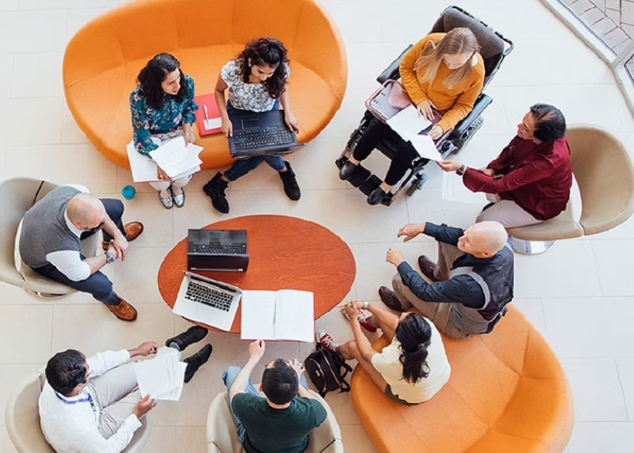
Service Etiquette How do we get there?
Many of us begin serving the fellowship prior to working steps and this can be evident in ways we interact with one another. As we learn, grow, and mature we hopefully take the new behavior into our service commitments.

Slide 10
Some examples of service etiquette are:
Arriving early or on time for service commitments
Arriving prepared with supplies
Remaining in the meeting for the allotted amount of time
Allow the facilitator to facilitate and only speak when recognized
Not interrupting or talking over others in round table discussions
Respecting the views and opinions of others
Not accepting bullying or aggressive behavior, there are appropriate ways to express opposition or dissatisfaction with what is happening.
Not having side conversations and taking disruptive talking out of the room
Not using our knowledge and experience as weapons and only in the furtherment of our efforts
Being “present” and engaged during sessions, this communicates respect.
If you wouldn’t have it said or done to you, don’t say it or do it to anyone else.
Teaching the people coming up behind us how to behave in service. “Each one teach one”.
What are other service etiquette suggestions can you offer?

Slide 11
We would like to thank everyone that attended and participated in this very important topic that is integral to the health and growth of our fellowship.
Questions?
Charlotte H and Kristi-Beth F

